Slide 1
RSNA Pediatric Bone Age Estimation
Jayaashri Chezhian

Slide 2
Table of contents
01
05
02
06
03
07
04
08
Preprocessing
Introduction
Baseline Model Training
Background
Objective
Baseline Model
Results&Analysis
Dataset
Multi-Input Extension

Slide 3
Table of contents
09
12
10
13
11
Limitation & Future Work
Multi-Input Model Training
Results & Evaluations
Conclusion
Grad-CAM

Slide 4
01
Introduction
a

Slide 5
Introduction
• What is Bone-Age?
Radiographic assessment of skeletal maturity in children.
• Clinical Importance:
Diagnosis and management of pediatric growth and endocrine disorders.
• Problem with Manual Assessment:
O High inter-observer variability
O Time-consuming process (10-15 minutes per image)
• RSNA Challenge (2017):
Benchmark dataset for automated bone-age estimation using hand X-rays.

Slide 6
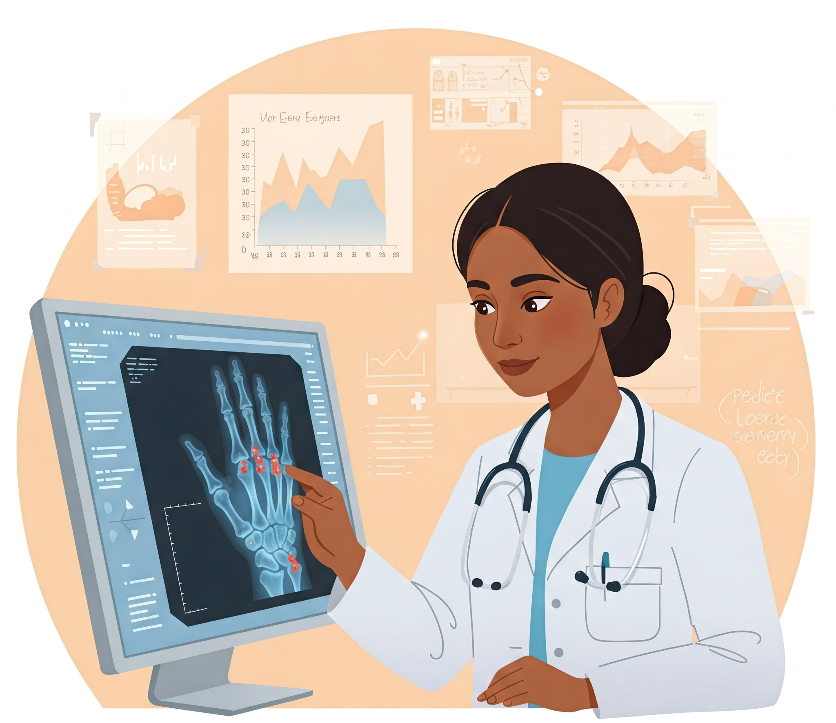
02
Background
a

Slide 7
Background
• Clinical Use of Bone-Age:
o Monitor pediatric growth
o Detect hormonal disorders or developmental delays
o Plan interventions (e.g., growth hormone therapy)
• Why Automate?
o Faster assessments
o Consistent, objective results
o Scalable across healthcare settings

Slide 8

03
Objective
a

Slide 9
Primary Objective
Predict bone age in months from hand X-ray images.
Key Metrics
Predict bone age in months from hand X-ray images.
Secondary Objective
Incorporate patient sex to improve accuracy.
Analysis Goal
Error Distribution by age and sex.
Explainability via Grad-CAM.

Slide 10

04
Dataset
a

Slide 11
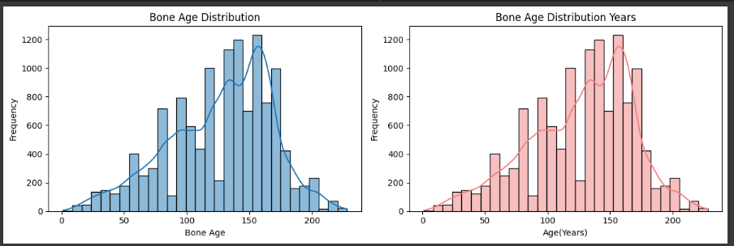
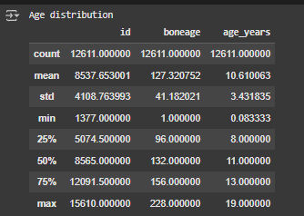
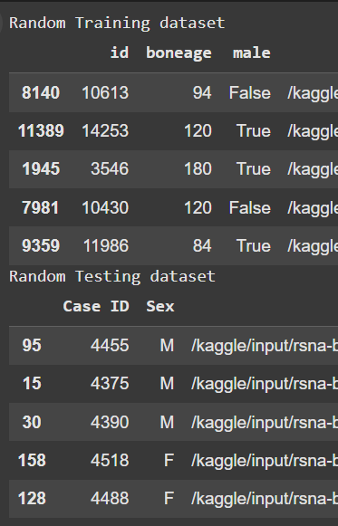
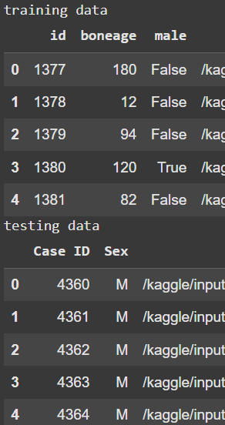
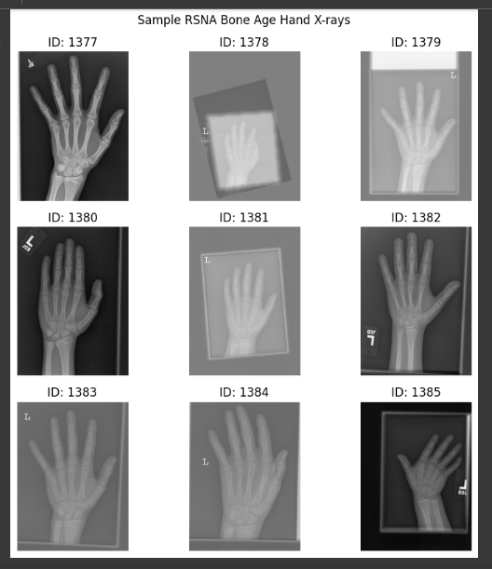
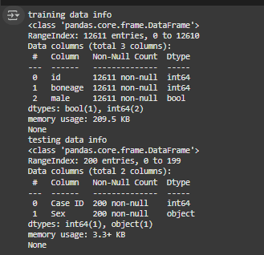
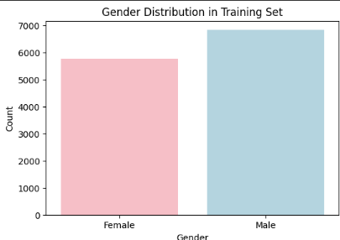
RSNA Bone
• Dataset Overview (RSNA):
O 12,611 labeled hand X-rays (training)
O Labels: Bone-age (months), Patient sex

Slide 12
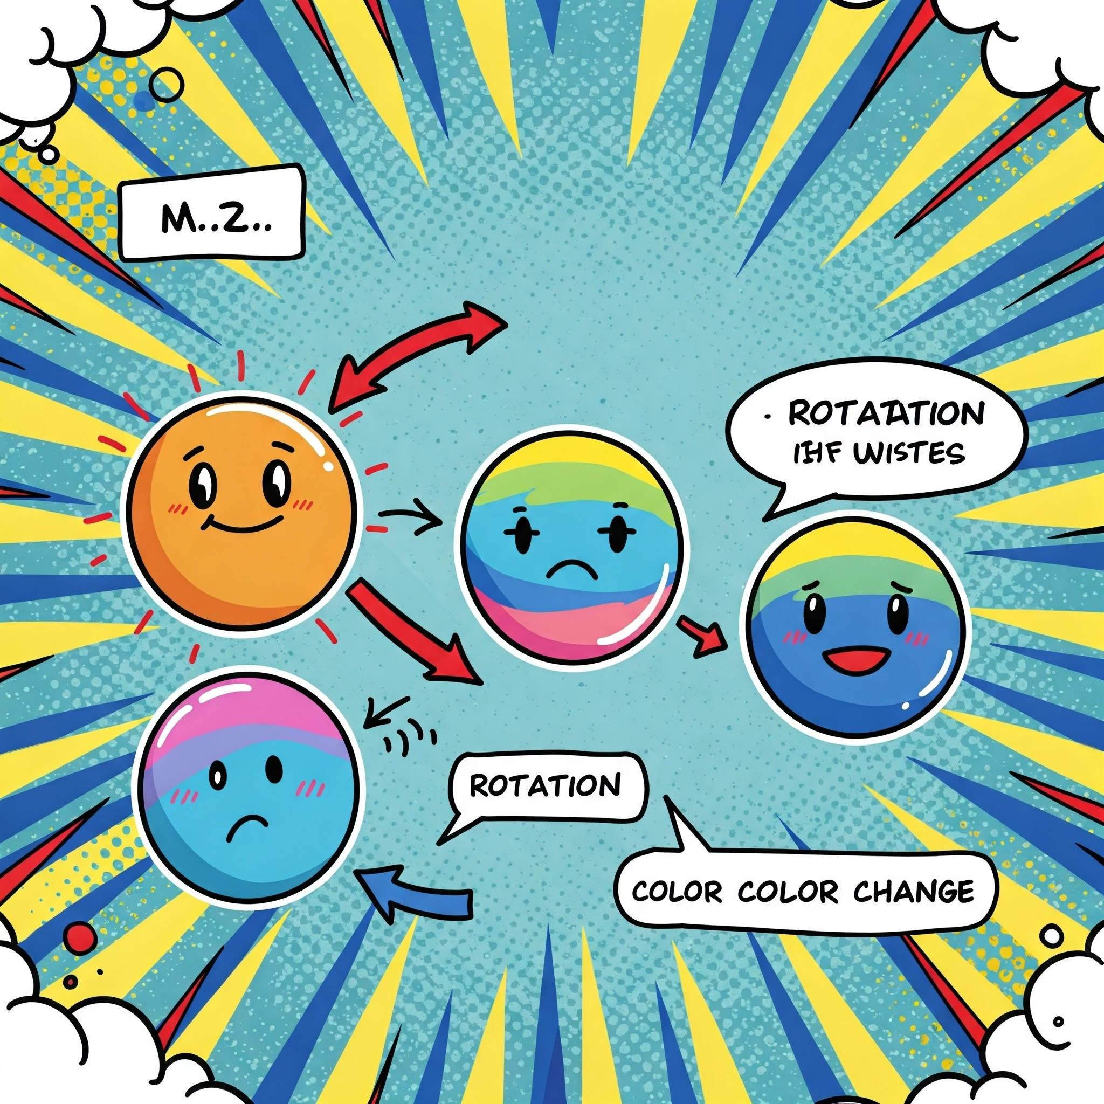
05
Preprocessing
a

Slide 13
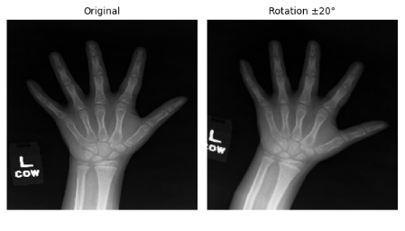
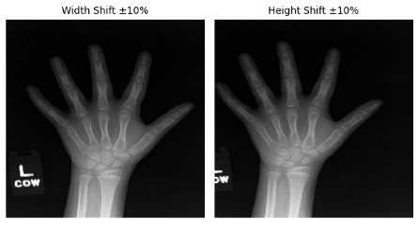
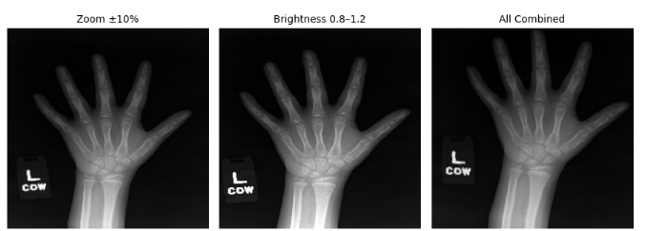
Preprocessing Steps
O Resize images to 224×224
O Normalize using ImageNet standards (EfficientNet preprocess)
O Augmentation (rotation, shifts, brightness; no horizontal flips)

Slide 14

06
Baseline Model Training
a

Slide 15
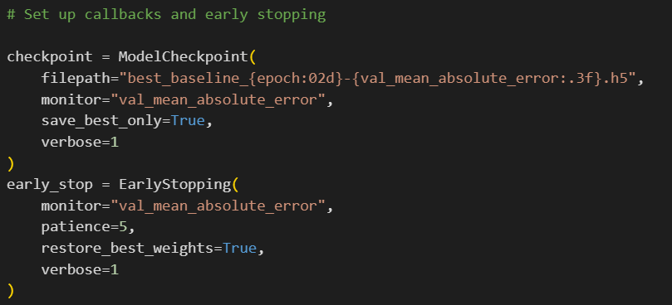

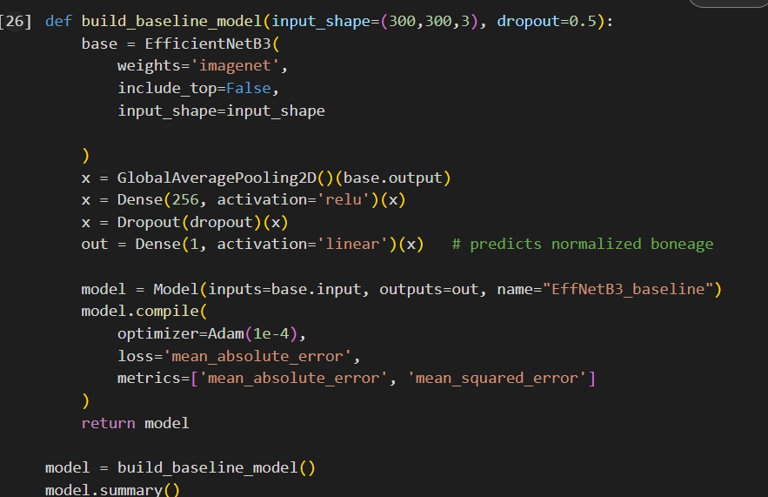
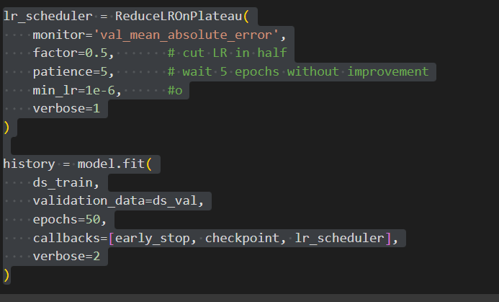
Basemodel
• Model Architecture:
EfficientNet-B3 (pretrained)
• EfficientNet-B3 → GAP → Dense(256, ReLU) → Dropout → Dense(1, Linear)
• Loss:
Mean Absolute Error (MAE)
• Optimizer: Adam (lr = 1e-4)

Slide 16
50
32
Early stopping & Dropout
Epoch
Batch Size
Overfitting

Slide 17

07
Baseline Model
Results&Analysis
a

Slide 18
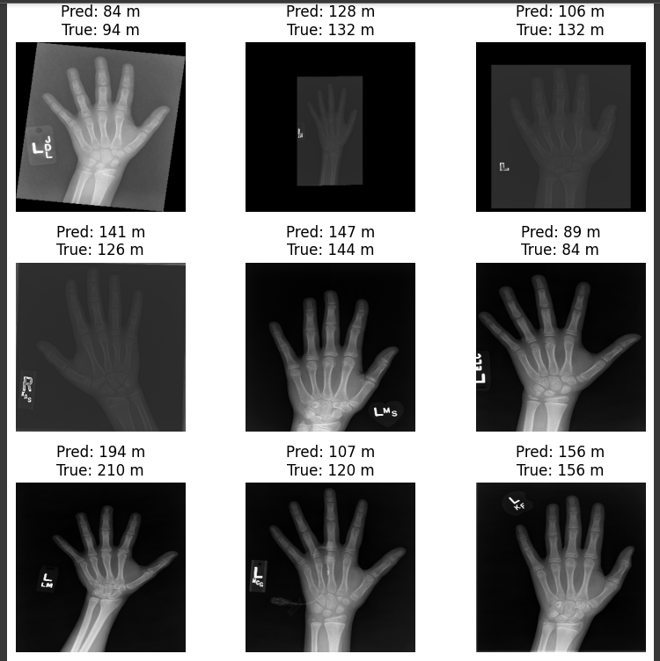
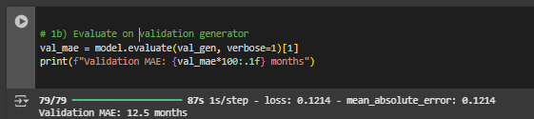
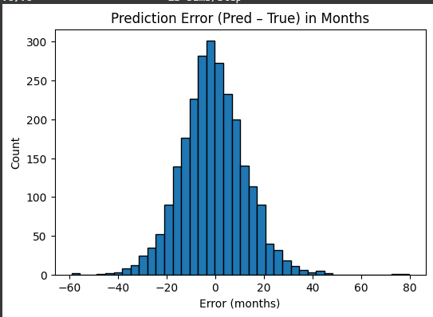
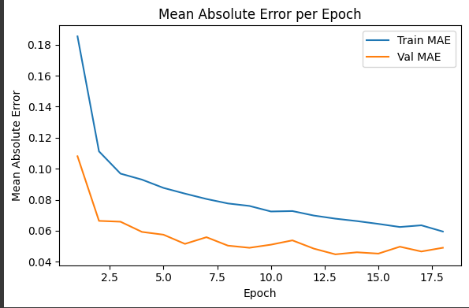
Result & Analysis
Final Validation MAE:
Error Distribution Analysis:
Training &
Validation curve
Observation
Some large prediction errors noted, potential gender-related bias.

Slide 19

08
Multi-Input Extension
a

Slide 20
Multi-Input Extension (Image + Sex)
• Rationale:
Skeletal maturity differs significantly between males and females.
• Proposed Solution:
Add sex as a secondary numerical input to CNN features.
Image I/P
Global Average Pooling
Sex
Concatenate
EfficienctNet B3 Model
Dense Layer
Dropout Layer
Output

Slide 21

09
Multi-Input Model Training
a

Slide 22
Multi-Input Model Training
• Data Pipeline (tf.data):
Efficient loading and batching for dual input (image, sex)
• Loss & Metrics:
o MAE loss on bone-age prediction
O Adam optimizer, similar hyperparameters as baseline
• Training Setup:
O Epochs: 40
O Callbacks: EarlyStopping & ModelCheckpoint

Slide 23

10
Results & Evaluation Metrics
a

Slide 24
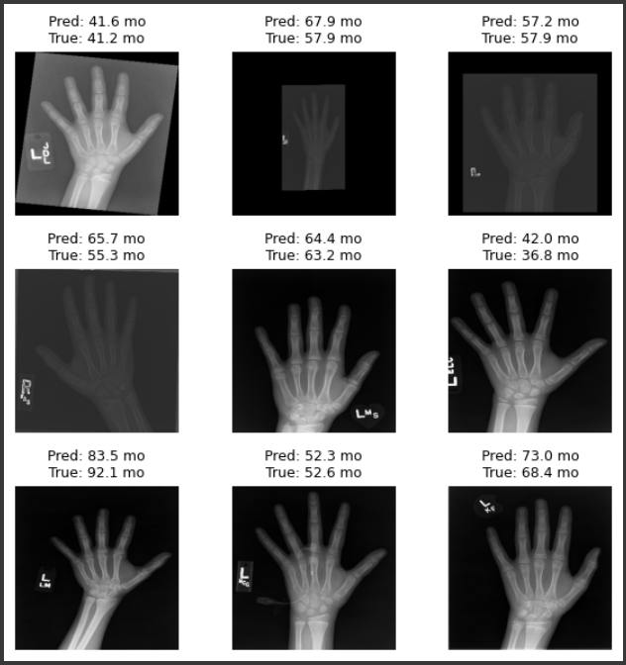
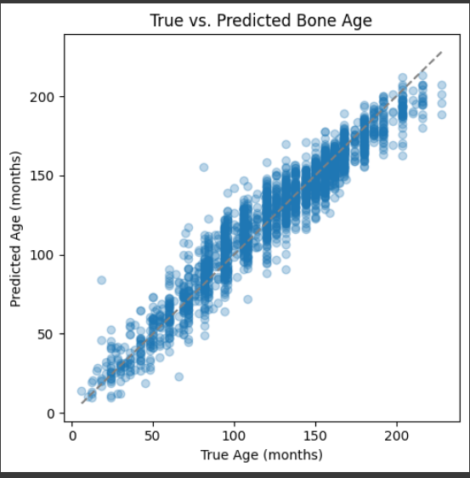
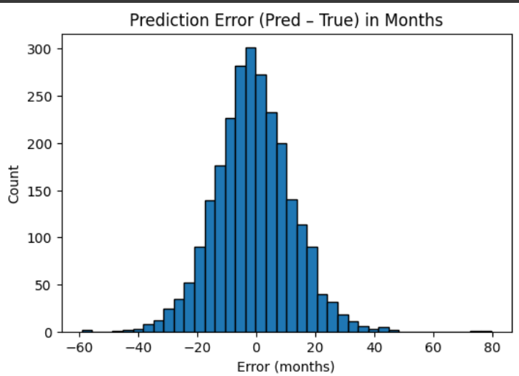
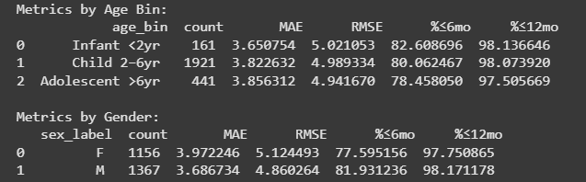
Result & Analysis
• Validation MAE (Multi-Input):
Improved accuracy compared to baseline
• Metrics Computed:
O MAE, RMSE, R², Accuracy within ±6 and ±12 months
• Error Breakdown:
O MAE by sex (bar plot)
O MAE by age groups (bar plot)
• Insights:
Sex input significantly reduced errors, especially at critical age ranges.

Slide 25
Comparative Analysis
Aspect | Baseline Model | Multi-Input Model
Inputs | Hand X-ray image only | Hand X-ray image + Patient sex
architecture | EfficientNet-B3 → GAP → Dense → Output | EfficientNet-B3 → GAP + Sex → Dense → Output
MAE | 4.5 months | 3.82 months
R² Square | 0.900 | 0.926
Within±6mo Accuracy | 71.9% | 79.9%
Within ±12mo Accuracy | 96.0% | 98.0%
Training Time | ~2.5 hours(L4 GPU) ~40 mins (A100 GPU) | ~40 mins(L4 GPU) ~30mins(A100 GPU)
Interpretability | Grad-CAM focused on hand region | Similar, but more consistent by sex
Personalization | No adjustment for biological sex | Sex-specific predictions
Real-World Applicability | Moderate | Higher (sex-aware predictions)
l

Slide 26

11
Model Explainability (Grad-CAM)
a

Slide 27
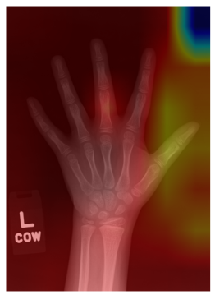
Grad-CAM
•What is Grad-CAM?
Visual explanation of CNN predictions highlighting important image regions.
•Observations from Grad-CAM:
O Model consistently focuses on relevant anatomical landmarks (growth plates, joints)
O Good predictions correlate with correct anatomical focus
O Mis-predictions may highlight ambiguous or unclear regions

Slide 28

12
Limitations &
Future Work
a

Slide 29
Limitations & Future Work
Limitations:
•Dataset bias towards certain age groups
•No direct incorporation of anatomical segmentation
•Limited dataset size (~14k samples)
Future Directions:
•Segmentation model to isolate anatomical structures
•Transformer-based architectures (ViT)
•Radiomics-based feature extraction with interpretable models (XGBoost)

Slide 30

13
Conclusion
a

Slide 31
Conclusion
•Successfully developed and trained CNN-based models (baseline and multi-input)
•Multi-input approach integrating sex significantly reduced prediction error
•Explained model predictions clearly using Grad-CAM visualizations

Slide 32
REFERENCE
https://www.kaggle.com/datasets/kmader/rsna-bone-age
https://www.kaggle.com/code/shantanurajmane/dataset-analysis-rsna
https://www.kaggle.com/code/gagandwaz/bone-age-efficientnetb4
https://www.tensorflow.org/tutorials/images/classification

Slide 33
THANK YOU
)

